Slide 1

Presents

Slide 2

Annual League Meeting
September 30th, 2026

Slide 3

National Club Basketball Association
850 Ridge Ave
Suite 301
Pittsburgh, PA 15212
Phone 412-321-8440 ext. 104
Fax 412-321-4088
www.NCBBAbasketball.org
Facebook: NCBBA
Twitter: @The_NCBBA
Instagram: @NCBBA_

Slide 4
Agenda
  What is CollClubSports?
  Meet the NCBBA Staff
  2025-2026 - Recap
  2026-2027 – What’s to Come
  Team Operations
  Timetable
  Sponsors and Fundraising
  Proposed Rule Voting Ballot Procedures
  Reminders
  Closing

Slide 5
What is CollClubSports?
National Federation of Collegiate Club Sports Leagues, L.L.C.
  National Club Baseball Association (NCBA DI, DII, & DIII)
    Founded 2000 – 34 teams – grown to 290 teams
  National Club Softball Association (NCSA)
    Founded 2006 – 33 teams – grown to 161 teams
  National Club Football Association (NCFA)
    Founded 2009 – 16 teams – grown to 16 teams
  National Club Basketball Association-Men’s (NCBBA-M)
    Founded 2013 – 28 teams – grown to 180 teams
  National Club Basketball Association-Women’s (NCBBA)
    Founded 2019 – 52 teams – grown to 102 teams

Slide 6
Mission
The National Federation of Collegiate Club Sports Leagues, L.L.C. (CollClubSports) is a compilation of governing bodies which oversee collegiate club athletics.
We are driven to provide collegiate student-athletes with the opportunity to participate in competitive, organized collegiate club athletic leagues, and to continually enhance this experience for all participants.
We strive to accomplish this by building lasting relationships based upon trust, commitment, dedication, understanding, and strong lines of communication.

Slide 7
Meet the NCBBA-M Staff
Front Office
President – Sandy Sanderson
Chief Operations Officer – Christian Smith
Vice President of Basketball Operations – Matt Hazi
Treasurer – Sandy Sanderson Sr.
Accounting Specialist – Jacob Kortenber
Rawlings Sponsor Acct. Manager – Amanda Lam
Travel/Fundraising Sponsor Acct. Mgr. – Eric Curitore
The Game Sponsor Acct. Manager – Felicia Battaglia
Tytan Athletics Sponsor Acct. Manager – Eric Curitore

Slide 8
Meet the NCBBA-M Staff
Regional Directors
Great Lakes Regional Director– Bryce Hammersley
Gulf Coast Regional Director – Matt Hazi
Mid-Atlantic Regional Director – Harrison Gillenwater
New England Regional Director – Walter Haupt
North Atlantic Regional Director – Robert Montgomery
Pacific Regional Director – Ben Ghilarducci
South Atlantic Regional Director – Michael Grogins

Slide 9
Meet the NCBBA-W Staff
Regional Directors
Great Lakes Regional Director– Mia Naman
Mid America Regional Director – Jon Frost
Mid-Atlantic Regional Director – Harrison Gillenwater
New England Regional Director – Walter Haupt
North Atlantic Regional Director – Robert Montgomery
Pacific Regional Director – Ben Ghilarducci

Slide 10
2025-2026 Skills Competition Winners
3-point Shooting Contest
  Tyler Schultz – UCLA
  Elise Dieterle – Cal Poly
Obstacle Course
  Jedd Wagner – North Carolina
  Alison Kunzwiler - Syracuse
Slam Dunk
  Jordan Hougeban – UCLA

Slide 11
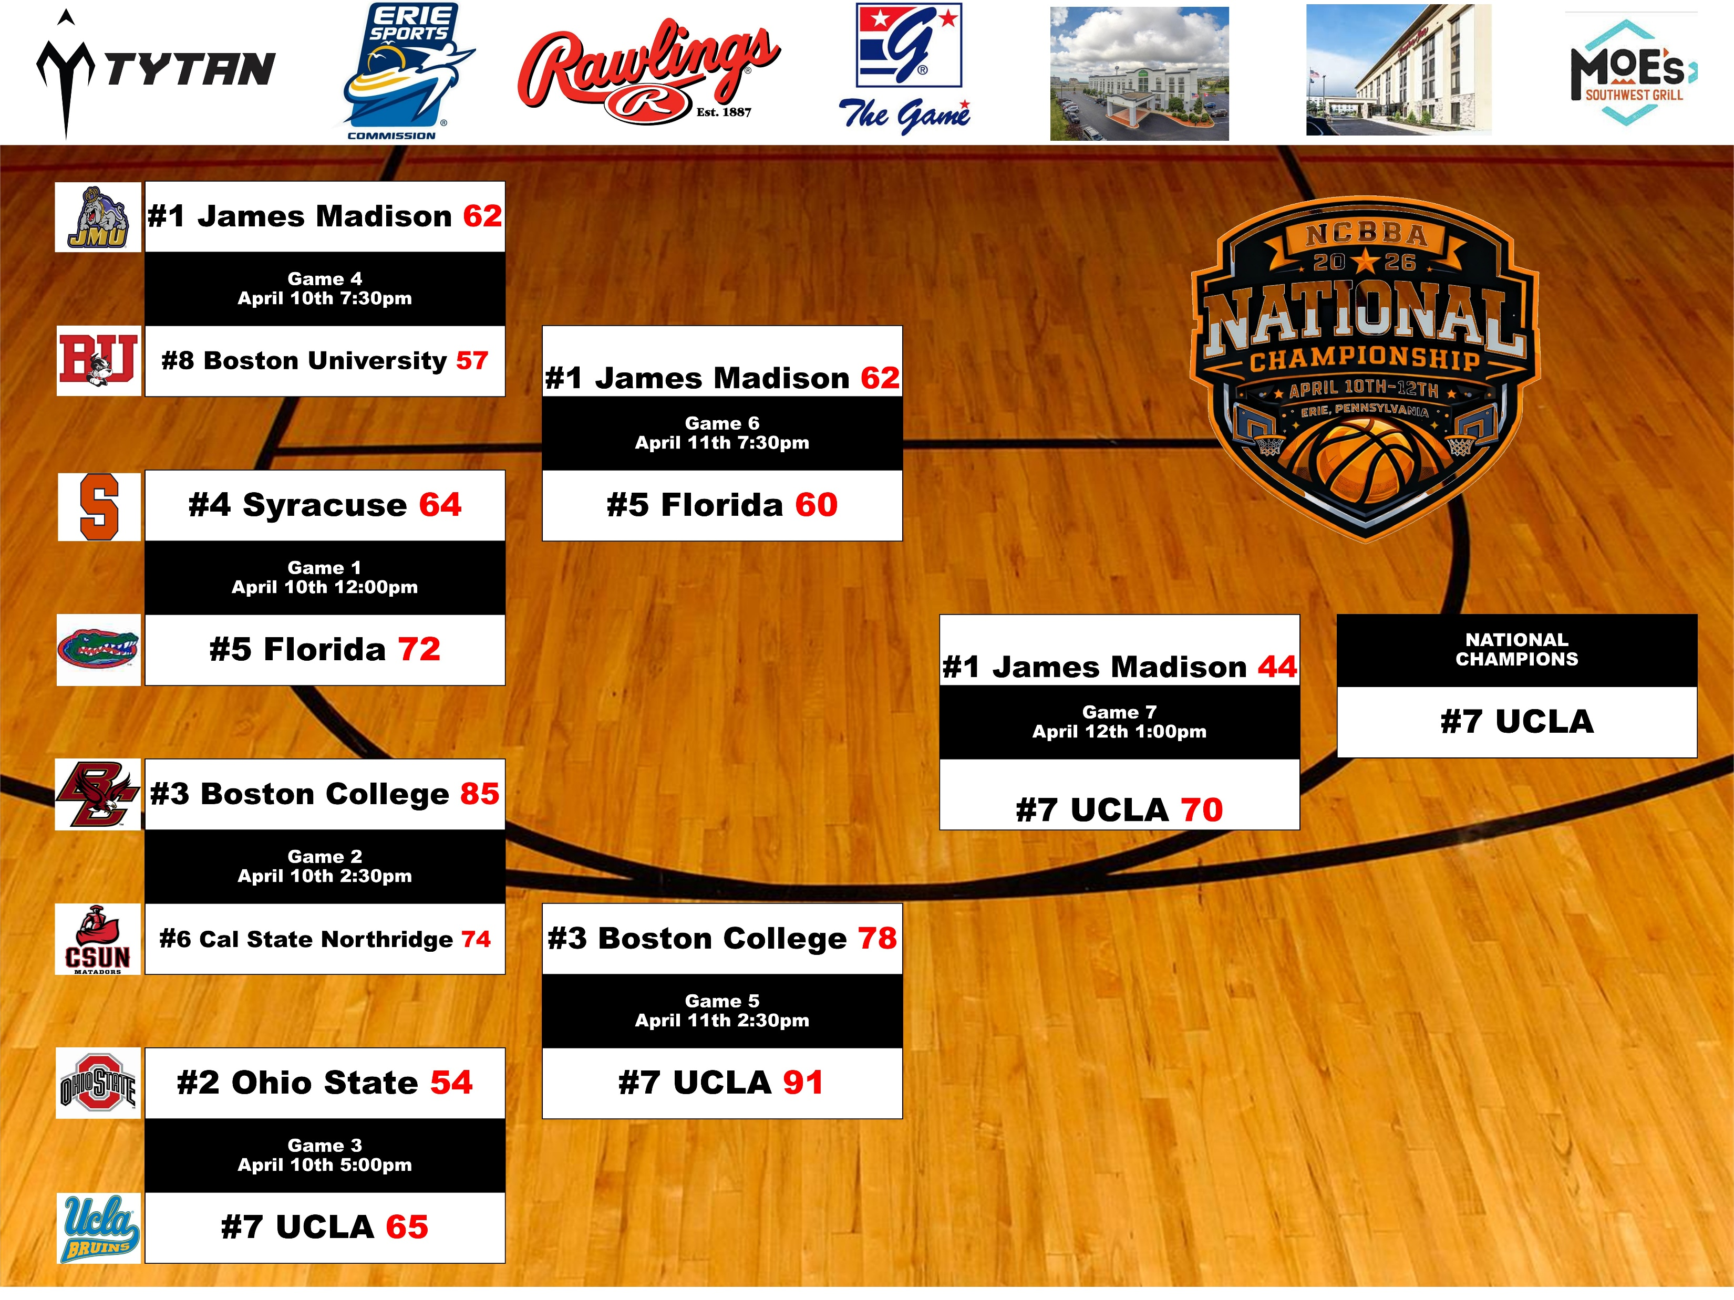
2025-2026 NCBBA-M National Championship Bracket

Slide 12
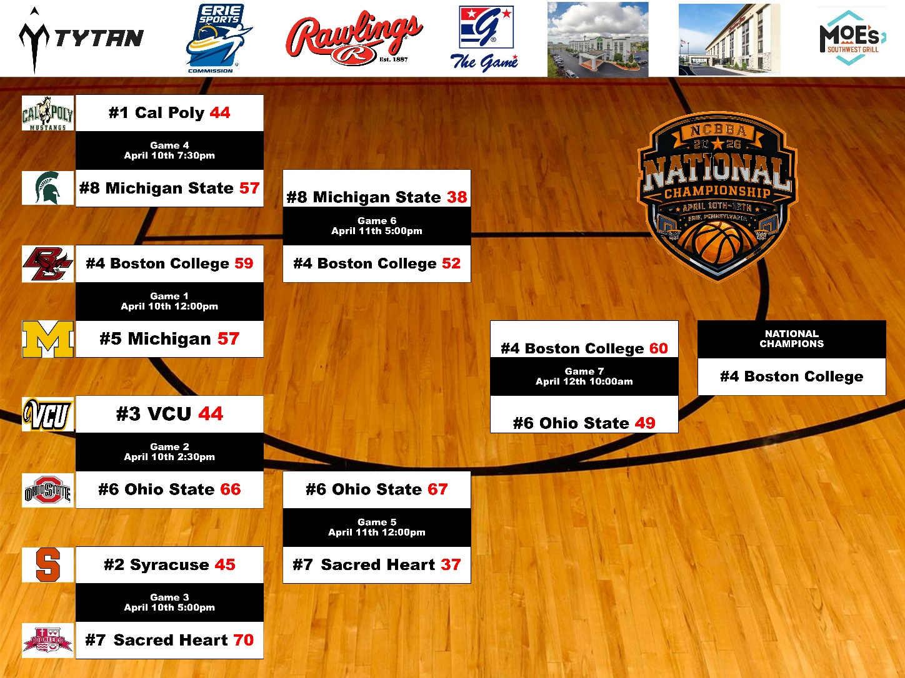
2025-2026 NCBBA-W National Championship Bracket

Slide 13
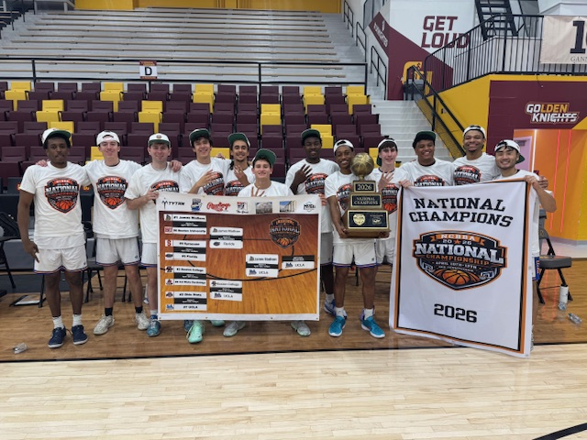
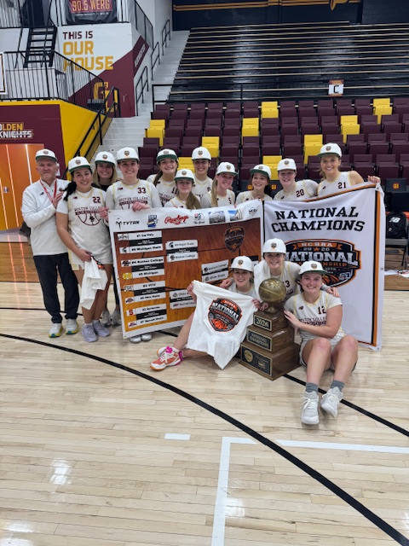
UCLA & Boston College are 25-26 NCBBA CHAMPIONS!

Slide 14
2026-27: What’s to Come
New Teams
Fall Tournaments
Tytan Athletics Top 20/15
Conference Realignment
Conference Scheduling
Regular Season
Regional Tournaments
National Championship

Slide 15
Potential New Teams
Expressed Serious Interest for 2026-2027:
Garner Webb
Wofford
Mercer
Southern Maine
Western Connecticut State
Westfield State
Amherst College
Buffalo
Army
Columbia University
Bryant & Stratton-Buffalo
USC Upstate
Manchester CC
Texas A&M
Florida Gulf Coast
Delaware State
UNC Pembroke
Miami OH
Nebraska-Omaha
NW Missouri State
Austin CC
Stephen F. Austin
Texas A&M
Ole Miss
Marquette
New Hampshire
Northern Illinois
Michigan Tech
UNLV
UC Davis

Slide 16
NCBBA Growth

Slide 17

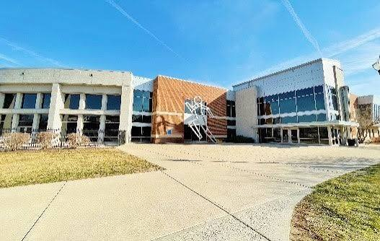
Fall Tip-Off Tournaments
1st Annual Hickory Hoops Classic (Partnered with Indiana State)
  Hosted at Indiana State Recreation Center
  Oct. 17th-18th
  10 Participating Teams

Slide 18
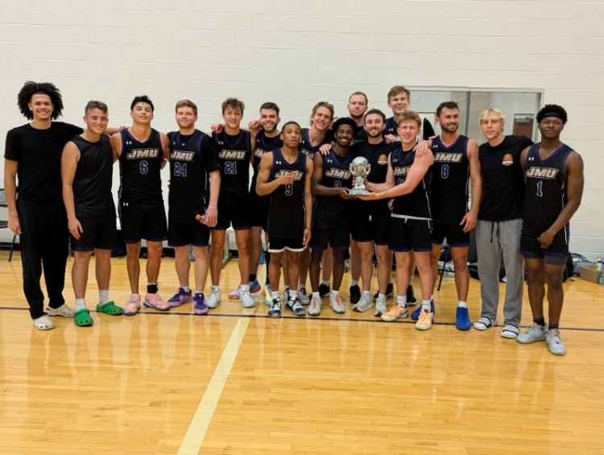
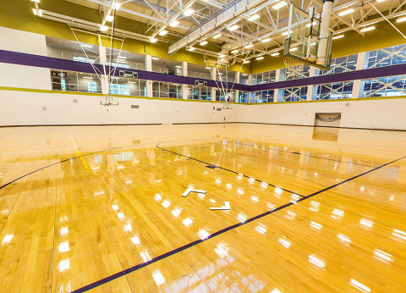
Fall Tip-Off Tournaments
3rd National Crown Invitational (Partnered with JMU)
  Hosted at JMU University Recreation Center
  Nov. 7th-8th
  12 Participating Teams
  Games will be live streamed via BallerTv

Slide 19
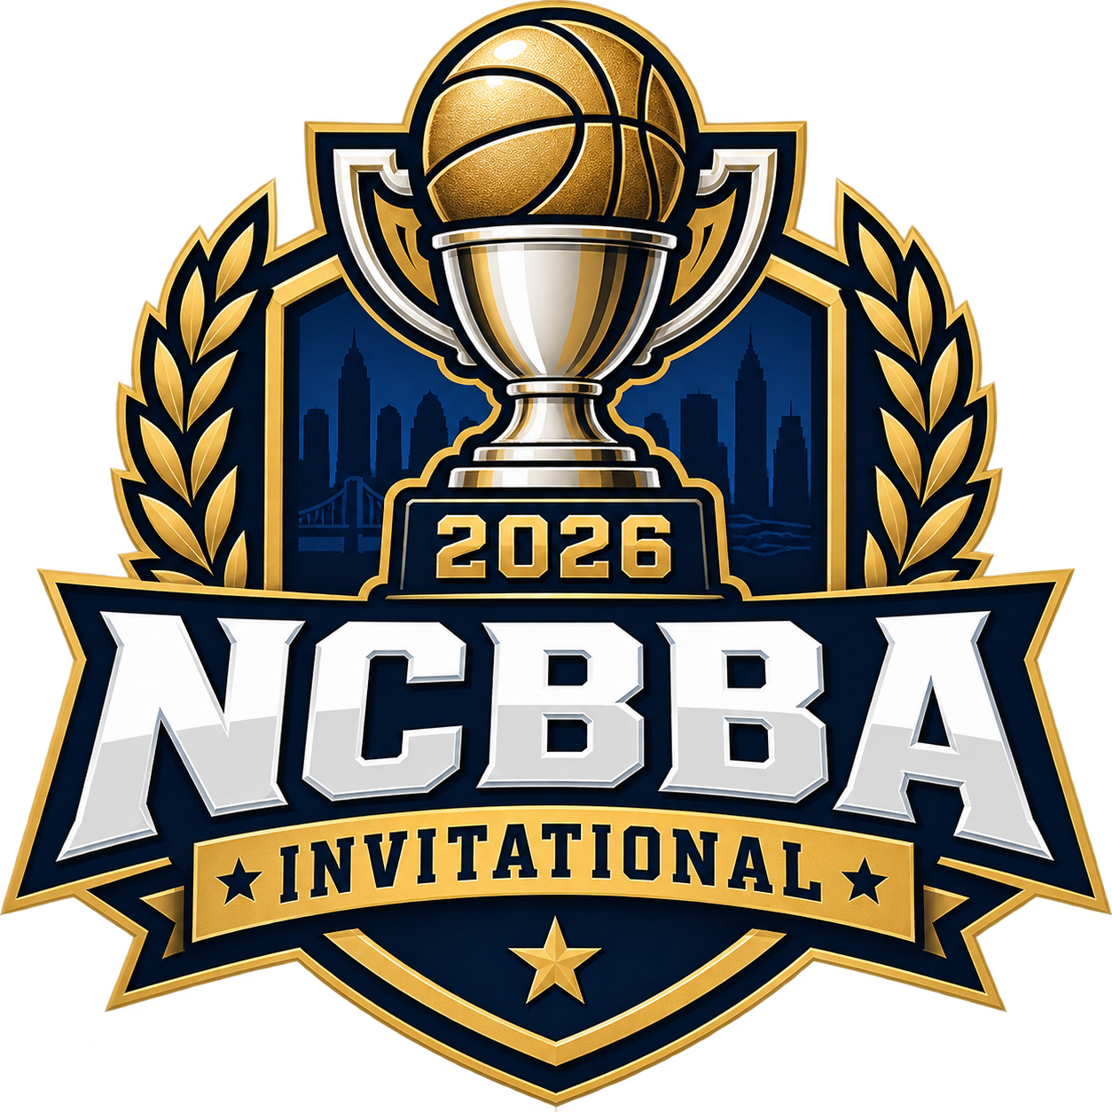
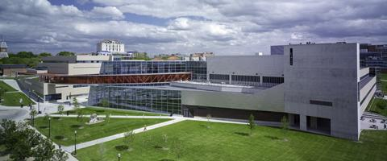
Fall Tip-Off Tournaments
1st NCBBA Invitational (Partnered with OSU)
  Hosted at OSU Recreation Center
  Dec. 4th-6th
  16 Men’s & 8 Women’s Participating Teams
    Top 16 Men’s & 8 Women’s teams in the NCBBA will be invited
  Games will be live streamed via BallerTv*

Slide 20
Tytan Athletics Top 20 Poll
Prior to the season, the NCBBA will assemble a Top-20 Voting Panel comprised of current/past NCBBA Coaches, Players and NCBBA Staff members.
During the season, scores will be submitted each Monday and the NCBBA website will be updated with results every Tuesday.
Every other week, the voting panel will submit a new Top 20 Poll voting ballot.
Poll Results to be used to help determine regional playoff seeding & 25% of the National Championship Tournament seeding formula
LOOKING FOR QUALIFIED, UNBIASED, OBJECTIVE VOLUNTEERS TO SIT ON VOTING PANEL

Slide 21
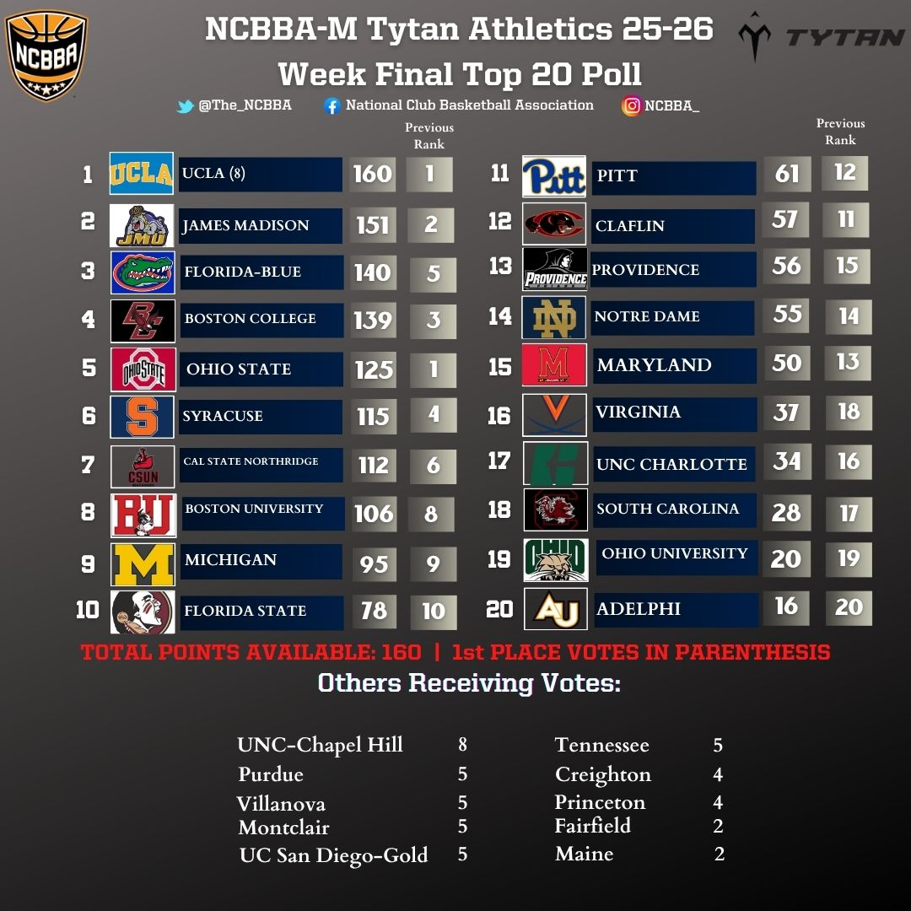
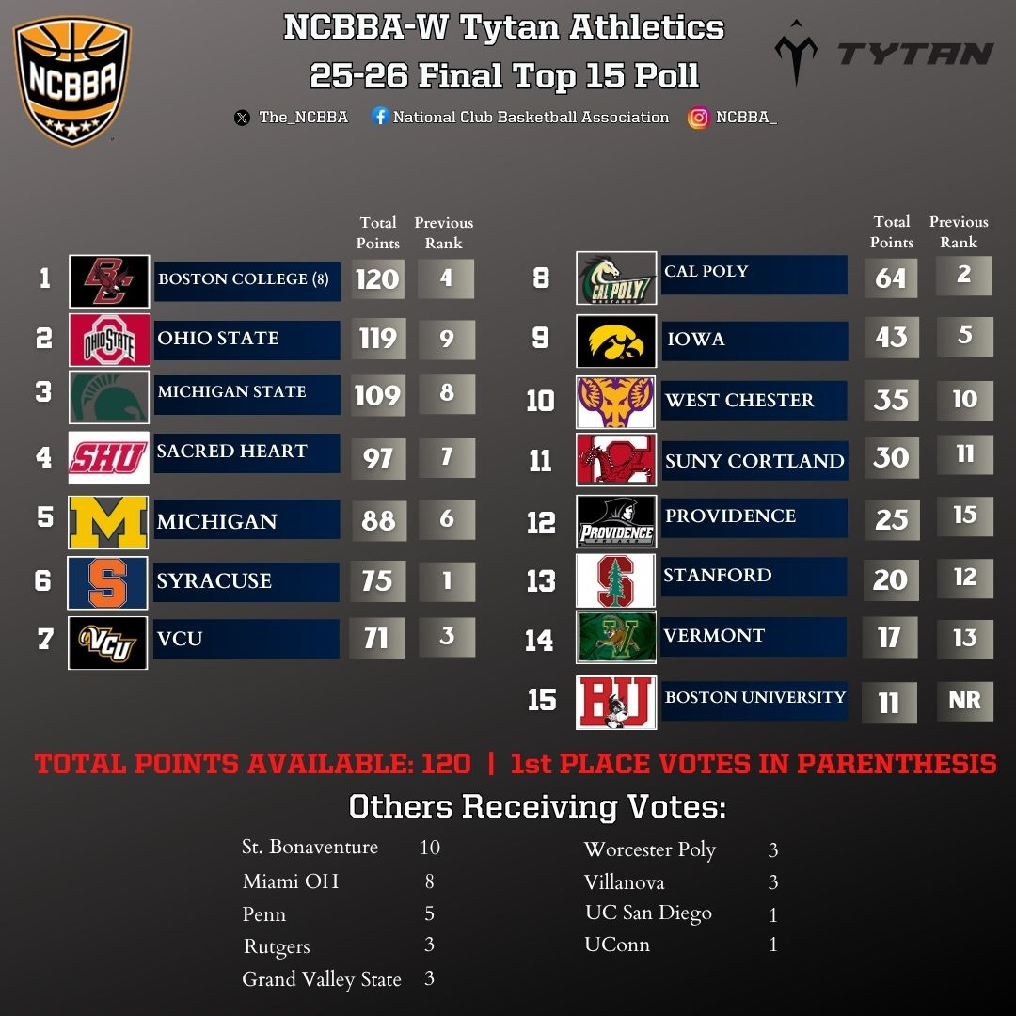
Tytan Athletics Top 20/15 Poll

Slide 22
Conference Realignment
Once NCBBA collects renewal LPA’s and completes enrollment of new teams (August), conferences will be realigned as needed to arrange teams geographically to minimize travel.
  NCBBA hopes to have membership numbers slightly above the 25-26 (180 NCBBA-M & 100 NCBBA-W).
  NCBBA hopes to create a Gulf Coast and/or Mid-America Region for 26-27.
  NCBBA hopes to further expand in California/Arizona
  NCBBA hopes to get South Atlantic Region back in NCBBA-W

Slide 23

Conference Scheduling
Schedule Request Form
  Due approximately Sept 15th – please adhere to deadlines
  Be accurate, be thorough, be flexible
  We are looking for availability first, then preferences
  See Sample Form on next slide
Goal is to have conference schedules released by Oct. 1st
After Conference Schedules are released, teams are encouraged to start scheduling non-conference games
  Once a non-conference game(s) are confirmed, regional directors must be notified so they can add them to the website

Slide 24
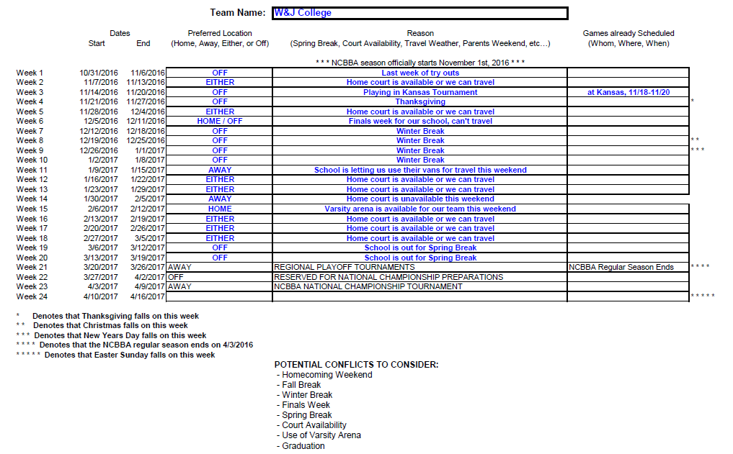
Sample Schedule Request Form

Slide 25
Regular Season
Regular Season will run from November 1st, 2026 – April 4th, 2027
Each team will be scheduled to play each conference opponent in a 2- game series
Each team can supplement their schedule with non-conference games at their discretion
  Non-conference schedules must be submitted to NCBBA admin in order to put on schedule and for teams to get credit
  Non-conference games can be against any COLLEGIATE basketball team (NCBBA, NAIA, NCAA, JUCO, etc…)

Slide 26
Regular Season
Every Monday night, NCBBA will request teams to complete a Weekly Team Submission form and email it to their conference coordinator reporting their scores, results, and Player of the Week nominations from the previous week
  NEEDS IMPROVEMENT! Quicker reporting of scores, and more Player of the Week nominations!
  NEEDS IMPROVEMENT! Keeping full and accurate stats during games and posting stats to website!
Every Tuesday, Conference Coordinators will update scores/results on the NCBBA website and select Conference Players of the Week
Every Wednesday, NCBBA will select National Players of the Week.

Slide 27
2027 Regional Tournaments
As the league continues to grow, eventually the entire league will be comprised of 8 Regions with multiple directional conferences funneling into Regional Tournaments.
Winners of the Regional Tournaments will automatically move on to the National Championship Tournament.
Ultimate Goal:
  8 Regions, 4 Conferences per Region, 8-9 teams per conference
Regional Tournaments are held in a single elimination format.
Held 2 or 3 weeks before the National Championship.
Regional Tournament formats for each region will be known once renewal & new team paperwork received and realignment completed.

Slide 28
2027 Regional Tournaments
Regional Tournaments will be April 10-11, 2027
NCBBA-M:
  Regional Tournaments will be hosted at a pre-selected, geographically central location for all teams in a specific region.
  Minimizes travel for qualifying teams
  Allows teams to plan/budget
  NCBBA to pay all officiating costs as well as court costs if applicable.
NCBBA-W:
  Regional Tournaments will be hosted at highest seeded team’s home court
  Pertains to Regions with less than 4 conferences

Slide 29
2027 National Championship
April 23-25, 2027
8-Team single elimination tournament
  Regional Champions and at-large selection(s) (if applicable) make up the field of teams
  National Championship also includes Skills Competition
Beginning in June, NCBBA will begin the search for our next National Championship Venue and host city.
Goal is to secure a venue that meets the needs/expectations of the member teams.
Encourage teams to offer suggestions especially if their on campus venue is available.
Return to Erie, PA is an option.

Slide 30
2027 National Championship
Search for a venue will be based on these priorities:
  1st – Tournament Location (Centrally Located)
  2nd – Preferred Tournament Weekend (Mid April)
  3rd – Tournament Venue (Small Collegiate Arena)
  4th – Court Surface (Hardwood)
  5th – Championship Game Time (Early Afternoon)
  6th – Venue to have onsite locker rooms
  7th – Auxiliary Practice Facilities

Slide 31
2027 National Championship
Improvement Goals:
  Further develop relationships with local business to come on as local event sponsors.
  Get both events under one roof
  Increase the league provided travel stipend to each participating team.
    Will be dependant on growth of league membership and ability to sign local sponsors.
  Create an advertising budget in order to further promote the event in hopes of boosting local attendance.
    We want our players to compete in front of a crowd.
  Have larger presence on social media.
    Entice non-qualifying teams to get there and non-member teams to join!

Slide 32
Team Operations
Being informed, organized and having strong lines of communications is key to a successful season.
League Participation Agreement (LPA)
  EARLY New Team Form (Due Date: April 18th)
  Existing Team Renewal Form (Due Date: June 1st)
  Signed by president of team, signed by club sports director or faculty advisor
  Fax or scan and email to NCBBA
Registration Form
  Provides full contact info to NCBBA front office
  Complete in full and email to NCBBA
  Important to include a secondary contact, team email and head coach if applicable
  Important to include advisor contact info

Slide 33
Team Operations
Being informed, organized and having strong lines of communications is key to a successful season.
General Liability Insurance
  $2,000,000 General Aggregate, $1,000,000 Per Occurrence
  Policy covers the NCBBA and it’s members (The Teams)
  Covers many aspects of NCBBA play (i.e. Travel, Practice, Workouts, Games)
  Full Year of Coverage
  Policy assists in obtaining court time & 3rd parties can be additionally insured for $75
  This policy helped protect the NCBBA and it’s members from potential financial losses from lawsuits, but, this is NOT a health or accident insurance policy

Slide 34
Team Operations
Being informed, organized and having strong lines of communications is key to a successful season.
Reserving Court Space
  DON’T PROCRASTINATE
  Contact opponents once schedule is released to set dates and times
    If opponent isn’t communicating, let NCBBA know to help facilitate communication
  Don’t wait till a week before you are to play
  Reserve court as soon as schedule is released
  3rd party additional insured
Scheduling Referees
  Contact local high school AD to gain contact info for local referee assignor
    If help is needed finding an assignor, let NCBBA know to help facilitate finding one
  2 High school certified (or better) referees per game
  Don’t wait till a week before you are to play
  Contact assignor as soon as schedule is released and re-confirm dates and times

Slide 35
Team Operations
Being informed, organized and having strong lines of communications is key to a successful season.
Team Manager Access & Online Player Registration
  At the beginning of each year, the “Team Manager” will need to request Team Manager access from the NCBBA.
  NCBBA will give individual Team Manager Access which will allow the Team Manager to access the Team Code, view the Registration Queue and have other access that players do not have (updating Team Information).
  Players will receive a TEAM CODE from their team manager to begin the player registration
  Individual Players register by either choosing “Existing User/Returning Login” or “First Time Player Registration” in the “Login” tab of the NCBBA sites.
  Players fill out information which determines eligibility
  Once registration is completed, players will be put in a “Registration Queue”
  Players able to log back in to upload a picture, bio and change certain information such as jersey number and position.

Slide 36
Team Operations
Being informed, organized and having strong lines of communications is key to a successful season.
Coaches Participation Waivers
  For non-playing coaches, managers, trainers, etc.
  MUST be typed, printed, SIGNED, then scan and emailed
  Coaches, managers, trainers, are NOT allowed on the court or on the bench unless they have a waiver on file with the NCBBA
  Found under “Info => Documents” tab of NCBBA websites (along with many other important documents to reference/utilize)

Slide 37
Team Operations
Being informed, organized and having strong lines of communications is key to a successful season.
Academic Eligibility Letter
  Sample format available under “Info” tab of NCBBA websites
  Must be signed by registrar, faculty advisor, or club sports director
  Can be scanned and emailed to NCBBA Front Office
  Must show currently enrolled, 12+ credits (9+ for 2 year schools), 2.0+ GPA, no academic warning, and no academic probation
  Players listed on AEL and listed in the Registration Queue, will be added to official NCBBA roster
Uploading player stats and team information
  Once players are cleared by the NCBBA as eligible and appear on the website roster, Team Managers may upload stats for those players
  Team Managers can login with their credentials (email & password) and will have ability to upload stats and other team information.
  Instructions on how to upload the stats and other team information will be sent once Login and Password are requested, but are also listed under the “Info” tab of NCBBA websites
  Teams are responsible for uploading their own stats
  It is the responsibility of the team to be sure that stats are entered accurately and in a timely fashion

Slide 38
Team Operations
Being informed, organized and having strong lines of communications is key to a successful season.
Weekly Team Submission Form
  Submit to Regional Director by midnight each Monday
  Be sure to enter scores/results for ALL games played during that week
  Be sure to submit a full stat line when nominating players of the week candidates
  Submit these on time to assure that your candidates receive consideration for awards
NCBBA Dues
  Includes 3 Official NCBBA Basketballs and $2 Million general liability insurance
  Teams will submit a refundable $150 performance bond due by October 15th. If your team did not forfeit any conference games, performance bond rolled over to current year.
  $999 due in full by February 28th
  $100 discount if paid in full by December 31st
  Credit Cards accepted but subject to online handling fee
  Invoices and receipts available through the NCBBA Accounting Specialist, Jacob Kortenber (Jacob.Kortenber@CollClubSports.com)
  EIN/Tax ID#: 52-2270910

Slide 39
Team Operations
Being informed, organized and having strong lines of communications is key to a successful season.
Boosting team interest
  Student involvement fair for incoming freshmen
  Advertisement/Coverage in school paper
  Flyers in freshmen dorms and common areas
  Create a social media groups/pages/accounts
  Make presence known on campus
Boosting Team Morale
  Get the team together off the court as much as on
  Social events where ALL are included can build strong bonds => leads to more success on the court
  Road trips build strong team chemistry
  Set room assignments on the road to break up “Clicks”
  Looking good can make players buy in to the club philosophy faster
    Coordinating uniforms, warmups and swag go a long way
  Being organized will give opponents the impression of strong leadership while instilling pride in your team to compete with confidence
    Arriving in uniform, team vans, choreographed warm ups, show opponents that you take things seriously
    Choreographed practices with a set practice attire sends that same message to your players

Slide 40
Team Operations
Being informed, organized and having strong lines of communications is key to a successful season.
Budgeting
  Very important to set accurate budget
  Make sure to include Expenses such as referees, courts costs, uniforms, equipment, travel expenses, league dues etc.
  Income items such as player dues, fundraisers, donations, school input, etc.
  BUDGET FOR POST-SEASON TOURNAMENTS EVERY YEAR!
Player Dues
  How much to charge?
  What is included?
    Travel costs? New Uniforms?
    More included = Higher Dues$
  Supply & Demand: Lots of interest = Higher Dues$
  Make them pay as soon as they make the team
    Players who practice for months then fail to pay dues hurt the team financially and chemistry
  Charge $5 for tryouts

Slide 41
Team Operations
Being informed, organized and having strong lines of communications is key to a successful season.
Team Equipment/Uniforms
  Order early as customized items tend to have extended lead times
  Order extra shorts and jerseys; uniforms do rip or go missing on occasion
  Order extra game basketballs when the supply runs low, NCBBA rules state you must use the Official NCBBA Basketball.
  Get quotes from NCBBA sponsors, there is a reason why the NCBBA endorses them
  Take advantage of additional NCBBA discounts during early ordering periods
  See list of NCBBA Sponsors and discounts provided on NCBBA website

Slide 42
Team Operations
Being informed, organized and having strong lines of communications is key to a successful season.
Guide To Collegiate Club Basketball
Developed by NCBBA in order to:
  Define and publicize the concepts and goals of the NCBBA
  Assist with the development and recruitment of new basketball teams
  Provide an all-inclusive reference manual to NCBBA league operations
  Assist with the improvement of member team basketball operations
Chapter Titles:
  What is the NCBBA
  Starting a team at your school
  Joining the NCBBA
  Operating w/in the NCBBA (Preseason, In-season, Post Season) *coming soon
  Making your team better *coming soon
  Fundraising and Sponsors *coming soon
  Chapters can be downloaded on the “Documents” tab of NCBBA website

Slide 43
Timetable
June 1st Renewal LPA deadline
^{September 30th League Meeting}
October 1st Conference Schedules released*
October 5th Proposed Rule Change Survey Due
October 9th Rules Ballots Due
October 16th Rule Book Released*
October 15th Team Previews Due/Performance Bond Due
October 29th Preseason Poll Released
November 1st Regular Season begins**
December 31st Deadline to receive Annual League Dues discount
February 28th Deadline for payment of Annual League Dues
April 4th Regular Season conclusion*
April 10-11th Regional Championship Tournaments*
April 23rd-25th NCBBA National Championship Tournament*
*Estimated Date
** Player Registration & Academic Eligibility Letters due 2 weeks before first game

Slide 44





Sponsors & Fundraising

Slide 45
Eric Curitore
Sponsor Account Manager
Eric.Curitore@CollClubSports.com
412-321-8440 x 101

Slide 46
FUNDRAZR
FUNDRAZR is an Official Fundraiser of the NCBBA
  Online fundraising platform for any budgetary need
  Start a campaign online completely free of charge
  Share on Facebook, Twitter, team websites and via e-mail to reach more potential donors

Slide 47
FUNDRAZR
  Invite players to share the fundraiser and make it a friendly competition within the team
  Customize your front page by adding information, pictures and videos to attract potential donors
  All you need are an e-mail address and a Verified PayPal Account to get started
  Contact Eric.Curitore@CollClubSports.com for how you can start a campaign

Slide 48
FUNDRAZR
  New way to use FundRazr
  Florida Club Football created sub campaigns for each individual player
  Each players campaign was tied to the Master campaign to tally up all donations as a group
  Great way to hold players responsible as well as start some friendly competition within the team

Slide 49
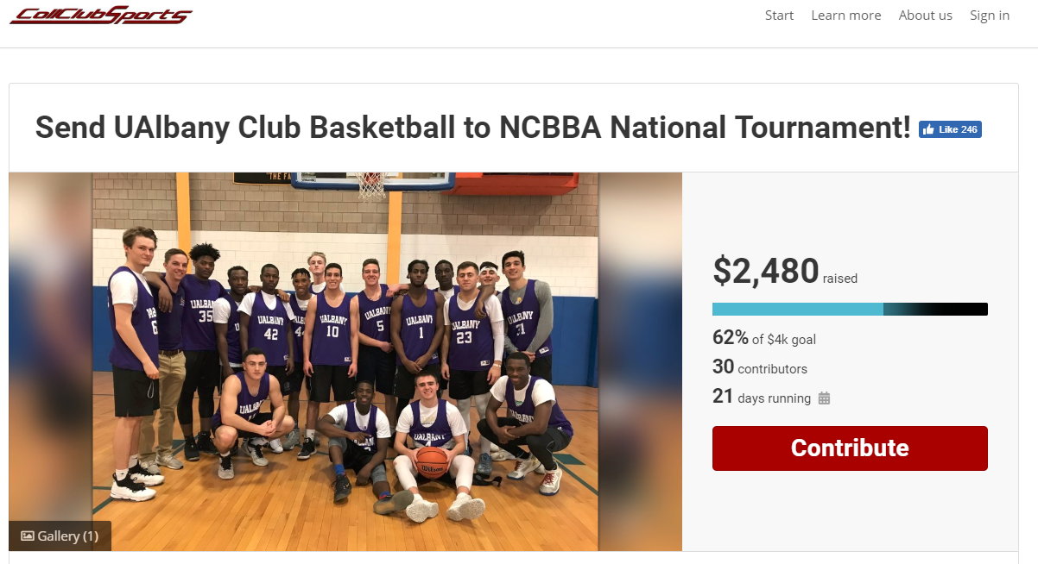
FUNDRAZR

Slide 50
Felicia Battaglia
The Game
Sponsor Account Manager
Felicia.Battaglia@CollClubSports.com
412-321-8440 x 107

Slide 51

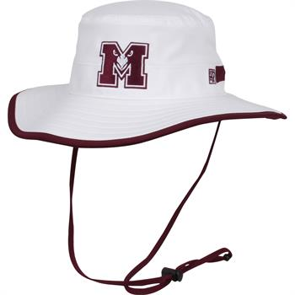
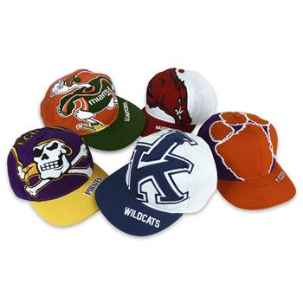
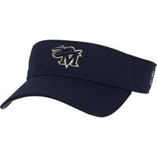
Official Headwear Sponsor of the NCBBA
Some Great Product Offerings:
- Beanies, Boonies, and Visors
    Pick your style, colors, and logo!
    Customizable Caps
Fundraisers
www.THEGAMEHEADWEAR.com

Slide 52
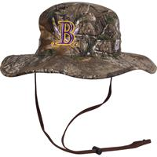
Exclusive low prices & customizations!
Early Order Discounts
Free NCBBA shield included
- Contact – Felicia Battaglia
        Email: Felicia.Battaglia@CollClubSports.com
        Phone: 412-321-8440 Ext. 107

Slide 53
Amanda Lam
Rawlings Sponsor Account Manager
Amanda.Lam@CollClubSports.com
412-321-8440 x 111

Slide 54
The Official Basketball of the NCBBA
  Each NCBBA member team will receive 3 Official NCBBA Rawlings basketballs FREE of charge.
  Each basketball will have the official NCBBA artwork.
  ONLY RAWLINGS basketballs are legal for Conference Games.

Slide 55
    Teams will receive equipment forms via email prior to the season to go about receiving their basketballs.
      Institution Name
      Name on Order
      Address
      City, State, Zip code
    Recommendation: use an ON-CAMPUS ADDRESS for basketballs shipment

Slide 56

Eric Cuitore
Tytan Athletics
Sponsor Account Manager
Eric.Cuitore@CollClubSports.com
412-321-8440 x 101

Slide 57

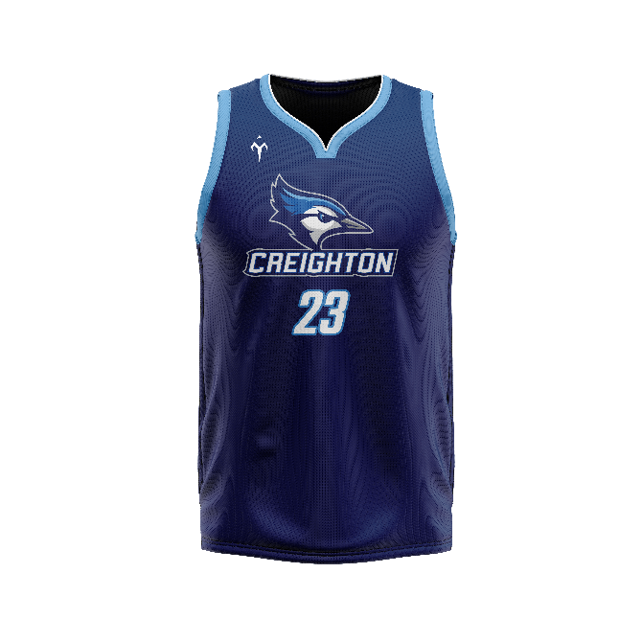
Official Uniform Provider of the NCBBA
Tytan Athletics offers exclusive prices on all stock & custom Uniforms EXCLUSIVELY to NCBBA teams!
  Fully customizable options
  4-5 Week Turn Around
  Each & every jersey & short garment will feature the NCBBA logo – FREE of charge
  Discounts Available!

Slide 58

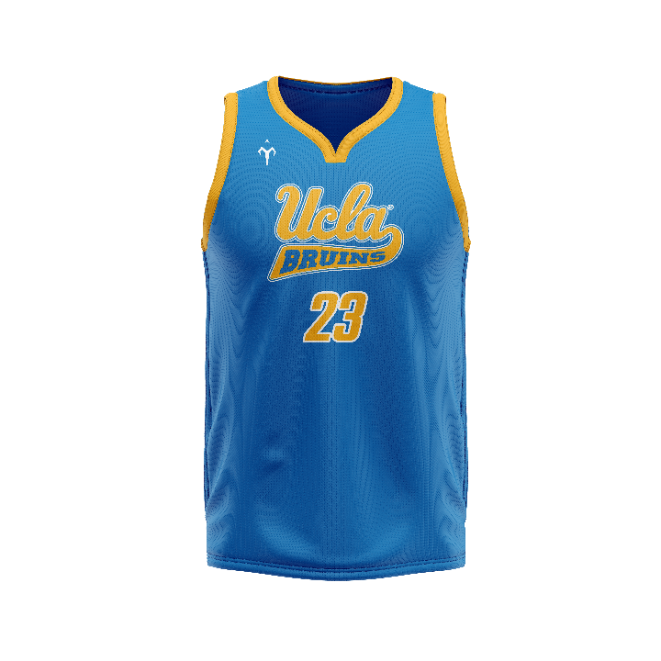
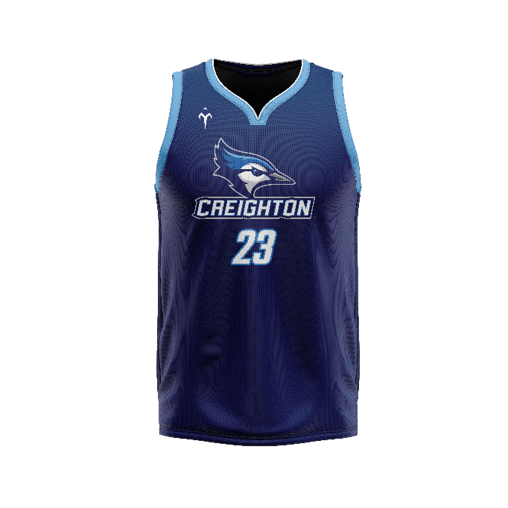
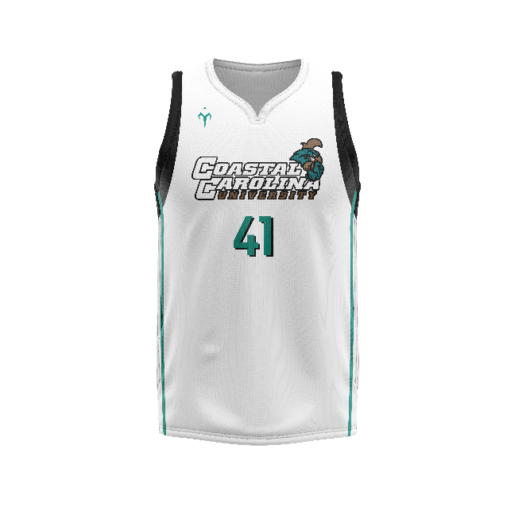
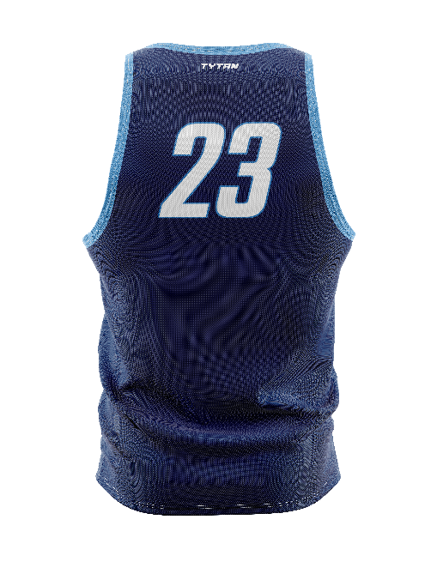
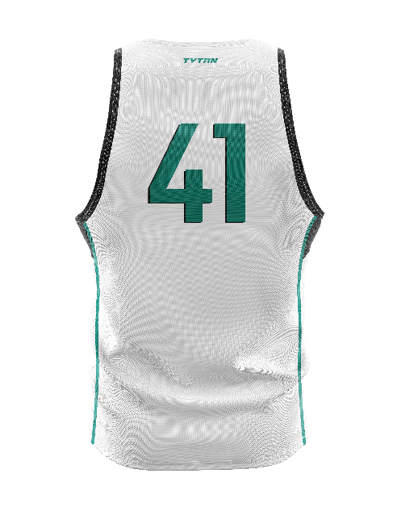
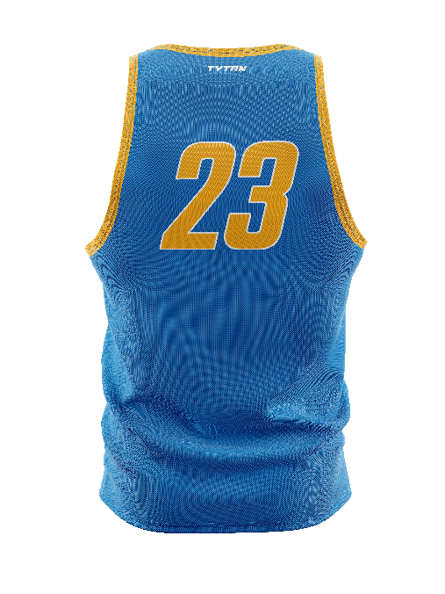
Tytan Athletics
Contact Bryan Johnson directly with Tytan Athletics at Tytan@TytanAthletics.com!

Slide 59
Proposed Rule Voting Ballot Procedures
Issues addressed one at a time
Open forum to create the ballot
Ballots will be emailed out tonight/tomorrow
Each team gets to submit 1 Voting Ballot
Voting Results Released in Approx. 1 Week

Slide 60
Reminders
Need more Player of the Week Nominations
Need more teams to record & enter stats
High School Certified Officials
Personal Fouls
  5 personal fouls
Number of Timeouts
  Timeouts – 4 60 second, 2 30 second
    Carry Over
    Extra 60 second timeout in each overtime

Slide 61
Reminders
Uniforms
  All Uniform Jerseys must match both in color and style including decorations and trim.
  Teams are starting to look sloppy with players having mismatched uniform jerseys.
    This is NOT IM basketball… let’s not make it look like it!
  Uniform Shorts only need to match in base color
  Teams should realize their players that are not technically in uniform risk ejection from the game (with warning).

Slide 62
Reminders
We Need Your Alumni!
    The NCBBA is looking for club basketball Alumni who want to volunteer to stay involved with the NCBBA as we grow.
    We are looking for:
    Regional Directors (Paid)
    Top 20 Voters
    Tournament Staff
    Great opportunity to stay involved, gain experience, or build a resume
    No out of pocket expenses, just want your passion to help the sport grow

Slide 63
Closing
Thank You for Tuning in
Promote the League & Website
Give the Sponsors Business whenever possible
Whenever Issues Arise, Please Notify Us
Let No Question Go Unanswered
Keep Lines of Communication Open
Please be Prompt Meeting Deadlines
It’s a Game!! Have Fun!!

